Slide 1
AFTON TOWNSHIP
ANNUAL TOWNSHIP
MEETING
APRIL 08, 2025
WELCOME

Slide 2
AGENDA
PLEDGE OF ALLEGIANCE
INTRODUCTION OF THE ELECTED OFFICIALS
LEGAL NOTICE

Slide 3
AGENDA
ELECTION OF MODERATOR
OATH OF MODERATOR
ADOPTION OF RULES

Slide 4

AGENDA
AGENDA APPROVAL
APPROVE 2024 ANNUAL TOWN MEETING MINUTES
SUPERVISOR’S ANNUAL REPORT

Slide 5
AGENDA
ROAD DISTRICT FINANCIAL REPORT
PRESENTATION
ROAD PROJECTS/ BUDGET

Slide 6
AGENDA
TOWN HALL PROJECTS
PUBLIC PARTICIPATION
APPROVE TRANSFER FROM SOCIAL SECURITY TO AFTON GENERAL FUND

Slide 7
AGENDA
APPROVE TRANSFER FROM PERMANENT ROAD TO ROAD & BRIDGE FUND
APPROVE RESOULUTION NO. 2025-2026 A001 OPPOSING LEGISLATION TO ABOLISH TOWNSHIPS
ESTABLISH A COMMITTEE TO IMPLEMENT AN EMERGENCY WARNING SIREN FOR AFTON TOWNSHIP
ESTABISH A BUILDING COMMITTEE TO PLAN FOR A FUTURE TOWN GARAGE

Slide 8
AGENDA
MOTION TO SET PLACD AND TIME FOR 2025-26 REGULAR TOWNSHIP MEETINGS
MOTION TO SET PLACD AND TIME FOR 2026 ANNUAL TOWNSHIP MEETING
APPROVE PAYMENT TO MODERATOR ADJOURN

Slide 9

SUPERVISOR REPORT

Slide 10
AFTON TOWNSHIP
TAX REVENUE/OTHER | AMOUNT
GENERAL TOWN FUND | $145,935
AUDIT FUND | $ 9,274
INSURANCE FUND | $ 2,144
IMRF FUND | $ 111
GENERAL ASSITANCE FUND | $ 55
TOTAL TAX REVENUE | $157,576

Slide 11
AFTON TOWNSHIP
EXPENDITURES | AMOUNT
ADMINISTRATION | $92,600
BUILDING/EQUIPMENT | $16,679
CEMEMTARY | $14,447
INSURANCE | $ 3,377
IMRF | $ 9,759
SOCIAL SECURITY MEDICARE | $
GENERAL ASSITANCE | $
TOTAL EXPENDITURES | $128,003
NET INCOME -/+ | $ 29,573

Slide 12
AFTON TOWNSHIP FUND BALANCES
FUND | AMOUNT
AUDIT – RESTRICTED | -$ 231
CORPORATE | $122.976
GENERAL ASSISTANTS – RESTRICTED | $ 48,475
IMRF- RESTRICTED | $ 10,415
INSURANCE LIABILITY - RESTRICTED | $ 10,381
SOCIAL SECURITY MEDICARE -RESTRICTED | $ 18,307
TOTAL RESTRICTED FUND BALANCE | $ 87,347
Ending Balance as of 3-31-2025 $191,169.41

Slide 13
AFTON TOWNSHIP RESERVE FUNDS
ILLINOIS TOWNSHIP LAW -RESERVE FUNDS | Target
Illinois Township laws don't specify a fixed dollar amount for reserves, but court cases suggest a reasonable limit of around 200% of the average expenses over the last three years. | $248,141

Slide 14
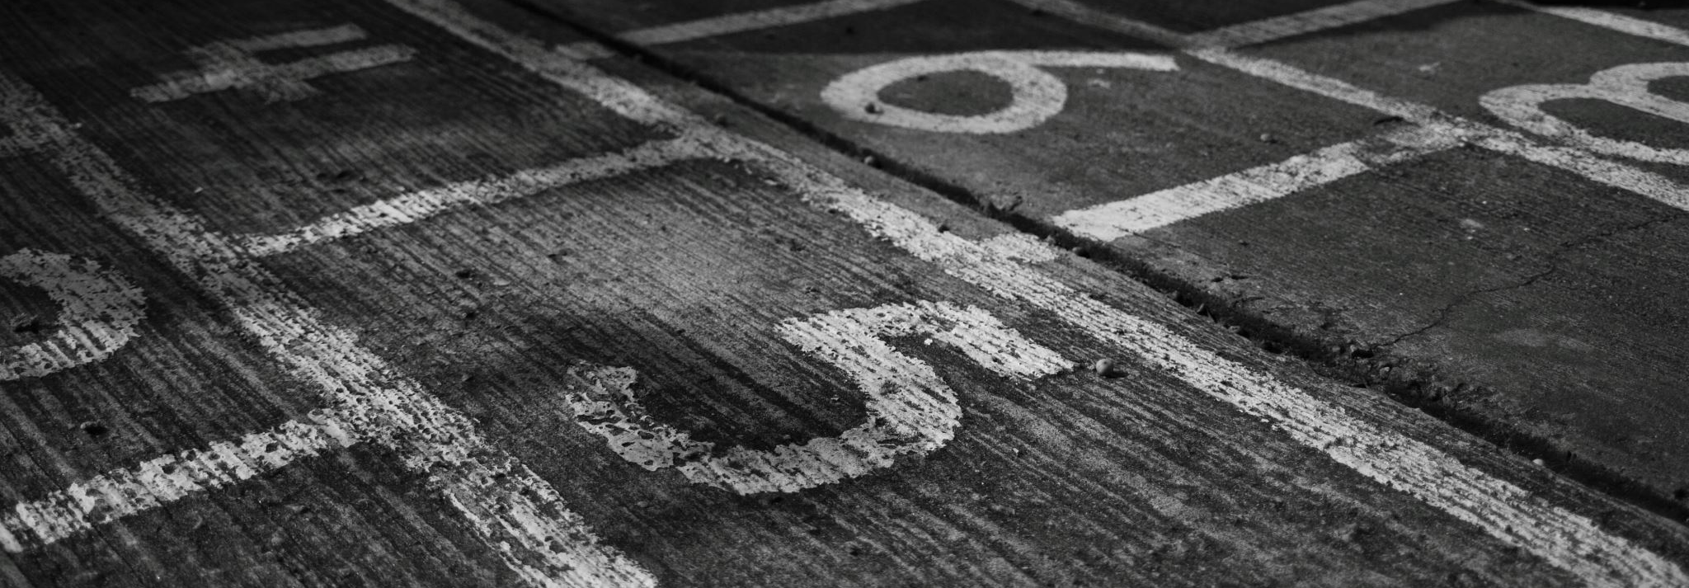
ROAD FINANCIAL REPORT

Slide 15
ROAD DISTRICT TREASURE REPORT
TAX REVENUE/OTHER | AMOUNT
GENERAL ROAD FUND | $305,612
PERMANMENT ROAD FUND | $138,069
JOINT BRIDGE | $ 21,262
EQUIPMENT & BUILDING FUND | $100,462
TOTAL INCOME | $565,406

Slide 16
ROAD DISTRICT TREASURE REPORT
EXPENDITURES | AMOUNT
ROAD MAINTANCE SERVICES & SUPPLIES | $ 80,793
EQUIPMENT OUTLAY | $132,339
PERMANMENT ROAD | $ 70,332
LOAN | $128,482
PAYROLL | $ 62,719
TOTAL EXPENDITURES | $368,557
NET INCOME -/+ | $196,848

Slide 17
AFTON ROAD DISTRICT FUND BALANCES
FUND | AMOUNT
BRIDGE/CONSTRUCTION– RESTRICTED | $162,852
EQUIPMENT & BUILDING - RESTRICTED | $ 38,694
PERMANMENT ROAD | $244,735
ROAD & BRIDGE | -$31.,049
Ending Balance as of 3-31-2025 $267,610

Slide 18
AFTON ROAD DISTRICT RESERVE FUNDS
ILLINOIS TOWNSHIP LAW -RESERVE FUNDS | Target
Illinois Township laws don't specify a fixed dollar amount for reserves, but court cases suggest a reasonable limit of around 200% of the average expenses over the last three years. | $572,313

Slide 19

PRESENTATION
AFTON
TOWNSHIP

Slide 20

Afton Township
Strategic Planning & Goal Development Initiative

Slide 21
Strategic planning is an effective way to identify and confirm an organization’s vision for the future and set organizational purpose and direction by incorporating clear priorities and measurable goals.
Afton Township (the “Township”) engaged the Northern Illinois University Center for Governmental Studies (NIU-CGS) in June 2023 to facilitate its strategic planning process.
From November 2023 through December 2023, the NIU-CGS team gathered internal and external stakeholder input that was shared at the leadership workshops held in February and March 2024.
The workshops were an opportunity for elected officials and Trustees to discuss a future vision for the Township and establish short- and long-term goals.
The workshop sessions also provided a positive atmosphere where workshop participants could discuss the best ways to serve the organization and the broader community in the coming years. The value of such processes continues to be recognized by policy-making boards, councils, and executive staff in both private and public organizations

Slide 22
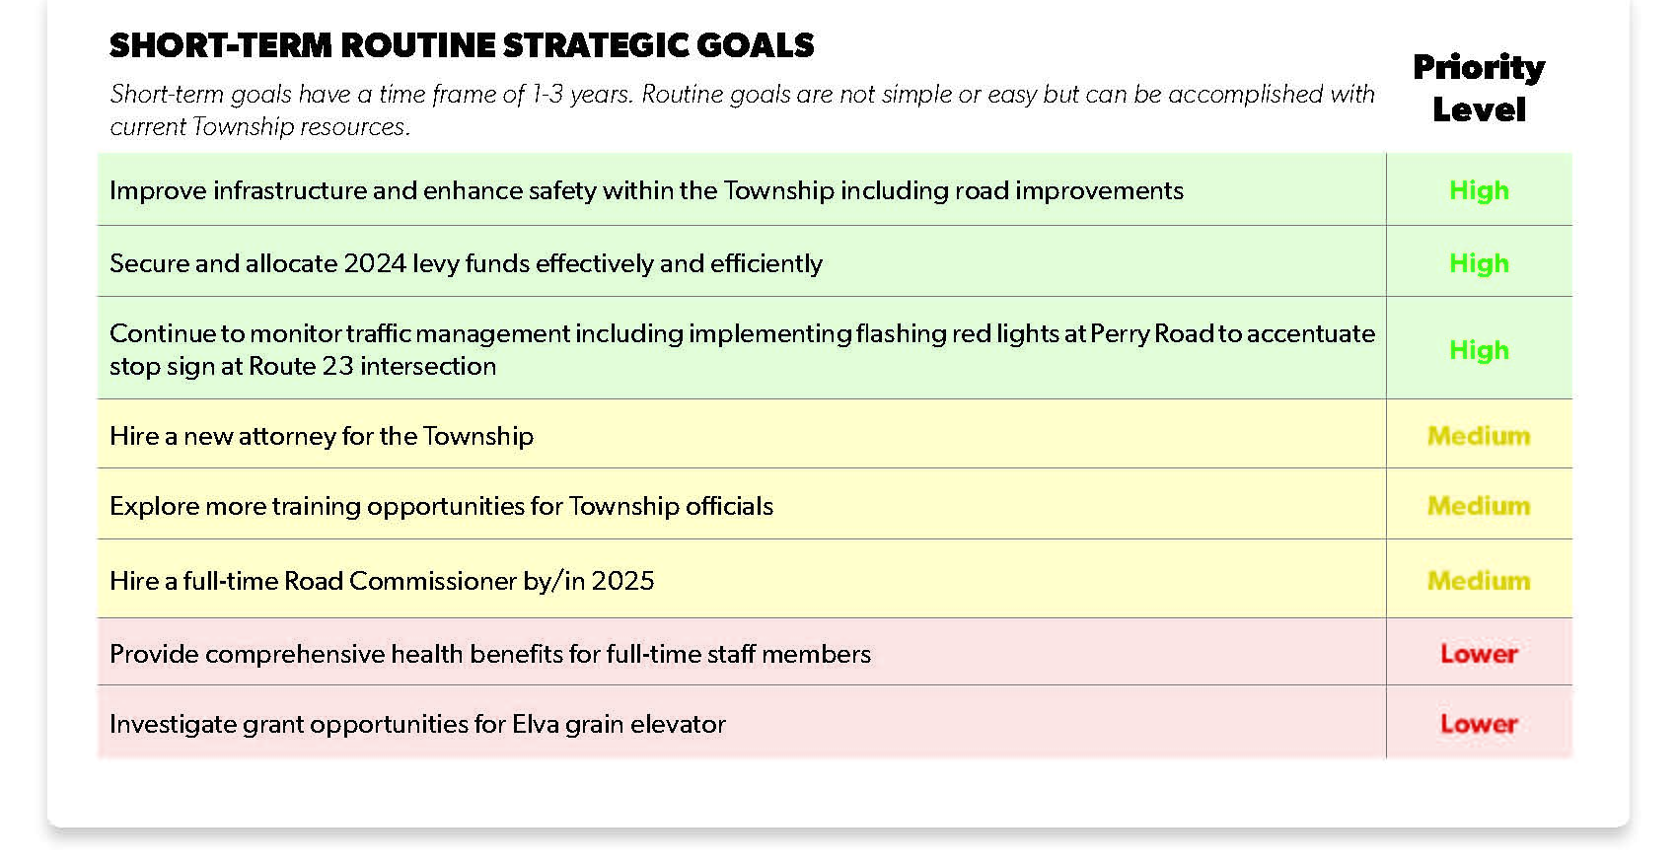

Slide 23
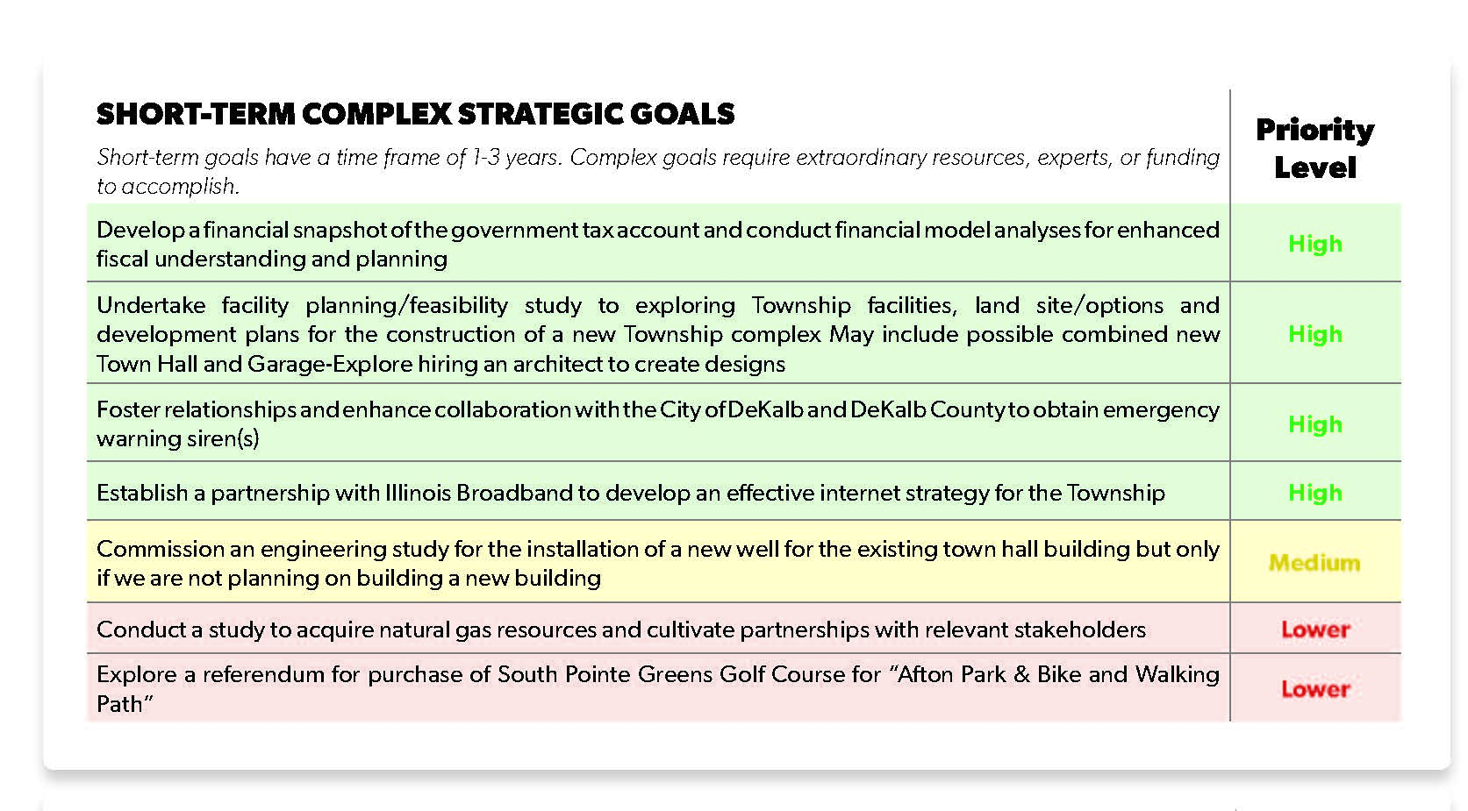

Slide 24
HOW CAN YOU GET INVOLVED?
COMMITTEE OPPORTUNITIES
BUILDING COMMITTEE
EMERGENCY WARNING COMMITTEE
WELL & SEPTIC COMMITTEE
BOARDBAND COMMITTEE
SIGN-UP SHEETS ARE IN THE BACK OF THE ROOM. One committee per person.

Slide 25


Slide 26


Slide 28
HOME $620,000 | Actual | Actual | Actual
TAXING BODY | 2022 TAX RATE | 2023 TAX RATE | 2024 TAX RATE | 2022 AMOUNT | 2023 AMOUNT | 2024 AMOUNT
COUNTY | 0.96690 | 0.89918
COUNTY PENSION FUNDS | 0.00076 | 0.00068
FOREST PRESERVE | 0.06696 | 0.06208
FOREST PRESERVE PENISON FUNDS | 0.00219 | 0.00196
AFTON TOWNSHIP | 0.0014263 | 0.0007894 | 0.0005028 | $ 264.12 | $ 149.27 | $ 103.98
AFTON TOWNSHIP PENSION FUNDS | 0.0000063 | 0.0000009 | 0.0000006 | $ 1.17 | $ 0.17 | $ 0.12
AFTON ROAD & BRIDGE | 0.0049211 | 0.0027152 | 0.0019403 | $ 911.29 | $ 513.41 | $ 401.25
DEKALB FIRE | 0.27220 | 0.27480
SCHOOL DISTRICT 428 | 5.77769 | 5.35012
SCHOOL DISTRICT 428 PENISON FUNDS | 0.31573 | 0.32515
CC 523 KISHWAUKEE | 0.59802 | 0.57512
CC 538 KISHWAUKEE SOCIAL SECURITY | 0.01072 | 0.00932
AFTON-PIERCE MULTI TWP | 0.03236 | 0.01988
AFTON DEKALB DRAINAGE #5
 |  |  |  | $ 1,176.58 | $ 662.85 | $ 505.35
EAV- Equalized Assessed Value | $ 185,180.00 | $ 189,088.00 | $ 206,798.00
Township Multiplier | 1.0676 | 1.0143 | 1.0935

Slide 29
HOME $300,000 | Actual | Actual | Actual | Actual
TAXING BODY | 2019 TAX RATE | 2022 TAX RATE | 2023 TAX RATE | 2024 TAX RATE | 2019 AMOUNT | 2022 AMOUNT | 2023 AMOUNT | 2024 AMOUNT
COUNTY |  | 0.96690 | 0.89918
COUNTY PENSION FUNDS |  | 0.00076 | 0.00068
FOREST PRESERVE |  | 0.06696 | 0.06208
FOREST PRESERVE PENISON FUNDS |  | 0.00219 | 0.00196
AFTON TOWNSHIP | 0.0018456 | 0.0014263 | 0.0007894 | 0.0005028 | $ 177.50 | $ 154.67 | $ 86.78 | $ 59.82
AFTON TOWNSHIP PENSION FUNDS |  | 0.0000063 | 0.0000009 | 0.0000006 |  | $ 0.68 | $ 0.10 | $ 0.07
AFTON ROAD & BRIDGE | 0.0074232 | 0.0049211 | 0.0027152 | 0.0019403 | $ 713.93 | $ 533.66 | $ 298.47 | $ 230.85
DEKALB FIRE |  | 0.27220 | 0.27480 |  |  | ]
SCHOOL DISTRICT 428 |  | 5.77769 | 5.35012
SCHOOL DISTRICT 428 PENISON FUNDS |  | 0.31573 | 0.32515
CC 523 KISHWAUKEE |  | 0.59802 | 0.57512
CC 538 KISHWAUKEE SOCIAL SECURITY |  | 0.01072 | 0.00932
AFTON-PIERCE MULTI TWP |  | 0.03236 | 0.01988
AFTON DEKALB DRAINAGE #5
 |  |  |  |  | $ 891.43 | $ 689.02 | $ 385.35 | $ 290.75
EAV- Equalized Assessed Value | $ 96,175.00 | $ 108,444.00 | $ 109,927.00 | $ 118,979.00
Township Multiplier | 1.0436 | 1.0676 | 1.0143 | 1.0935

Slide 30
Tax Year | Fiscal Year | EAV $$ | Road District Levy Dollars | Afton Road Tax Rate | Township Levy Dollars | Afton Twp Tax Rate
2018 | 2019-2020 | $ 42,226,524.00 | $ 313,037.89 | 0.74133% | $ 79,394.30 | 0.188020%
2019 | 2020-2021 | $ 44,030,769.00 | $ 326,849.21 | 0.74232% | $ 81,263.19 | 0.184560%
2020 | 2021-2022 | $ 46,218,178.00 | $ 275,742.27 | 0.59661% | $ 82,924.66 | 0.179420%
2021 | 2022-2023 | $ 50,044,609.00 | $ 300,127.53 | 0.59972% | $ 87,507.99 | 0.174860%
2022 | 2023-2024 | $ 97,461,289.00 | $ 479,616.75 | 0.49211% | $ 139,788.74 | 0.143430%
2023 | 2024-2025 | $185,096,169.00 | $ 502,573.12 | 0.27152% | $ 146,281.51 | 0.079030%
2024 | 2025-2026 | $458,683,240.00 | $ 889,850.00 | 0.19400% | $ 230,430.00 | 0.050237%

Slide 31
YEAR | EAV DOLLARS | ROAD DISTIRCT DOLLARS | Levy RATE |  | TOWNSHIP DOLLARS | Levy RATE
2023 | $185,096,196 | $502,573 | 0.2715% |  | $146,281 | 0.0790%
2024 | $458,683,240 | $889,850 | 0.1940% |  | $230,430 | 0.0502%
 |  | Change Rate | -40% |  | Change Rate | -57%
 | 148% | 77% |  |  | 58%

Slide 33
Salaries for 2025-2028
ELECTED POSITON/ EMPLOYEE | SALARY AMOUNT | IMRF Employer | IMRF Employer | Health Insurance | Total Salary Package
Supervisor | $ 15,120.00 |  |  |  | $ 15,120.00
Clerk | $ 6,500.00 |  |  |  | $ 6,500.00
Commissioner- Full Time | $ 60,000.00 | 8.830% | $5,298.00 | $ 26,400.00 | $ 91,698.00
Trustee | $ 2,400.00 |  |  |  | $ 2,400.00
Trustee | $ 2,400.00 |  |  |  | $ 2,400.00
Trustee | $ 2,400.00 |  |  |  | $ 2,400.00
Trustee | $ 2,400.00 |  |  |  | $ 2,400.00
Road Treasurer | $ 1,000.00 |  |  |  | $ 1,000.00
Salaries for 2021-2025
ELECTED POSITON/ EMPLOYEE | SALARY AMOUNT | IMRF Employer | IMRF Employer | Health Insurance | Total Salary Package
Supervisor | $ 7,395.96 |  |  |  | $ 7,395.96
Clerk | $ 4,500.00 |  |  |  | $ 4,500.00
Commissioner | $ 31,400.00 | 8.830% | $2,772.62 | $ - | $ 34,172.62
Trustee | $ 1,200.00 |  |  |  | $ 1,200.00
Trustee | $ 1,200.00 |  |  |  | $ 1,200.00
Trustee | $ 1,200.00 |  |  |  | $ 1,200.00
Trustee | $ 1,200.00 |  |  |  | $ 1,200.00
Road Treasurer | $ 1,000.00 |  |  |  | $ 1,000.00

Slide 34
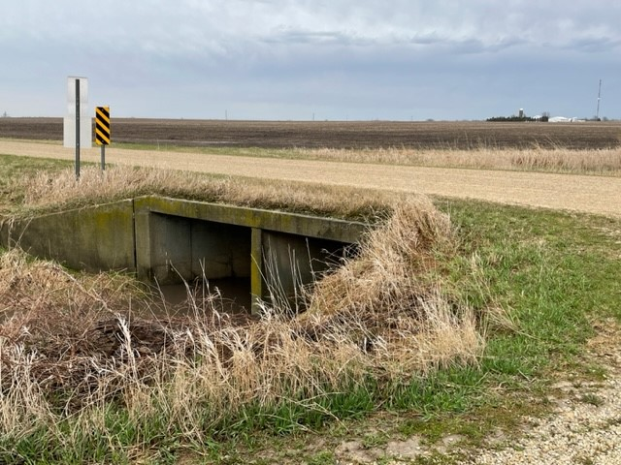
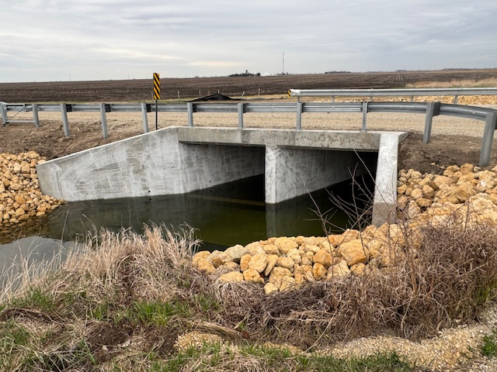
BEFORE
AFTER
BRIDGE PROJECT-ROAD DISTRICT
ANDERLAND ROAD

Slide 35
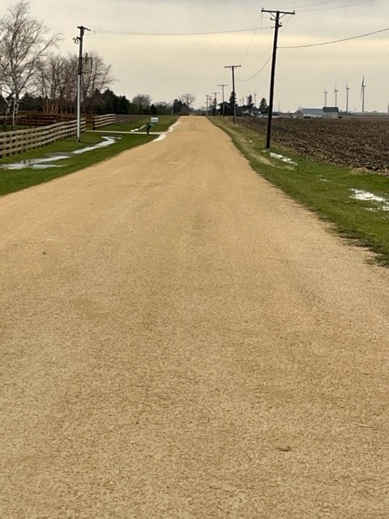
FUTURE CAPITAL FUND PROJECTS-
ROAD DISTRICT
McGirr Road Seal Coating
ESTIMATED BUDGET $395,000

Slide 36
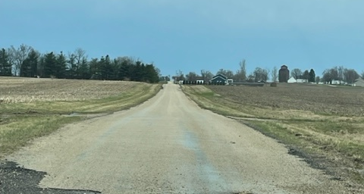
FUTURE CAPITAL FUND PROJECTS-
ROAD DISTRICT
Waterman Road Seal Coating
ESTIMATED BUDGET $175,000

Slide 37
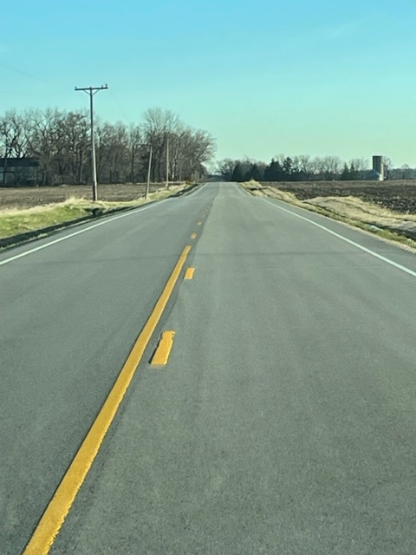
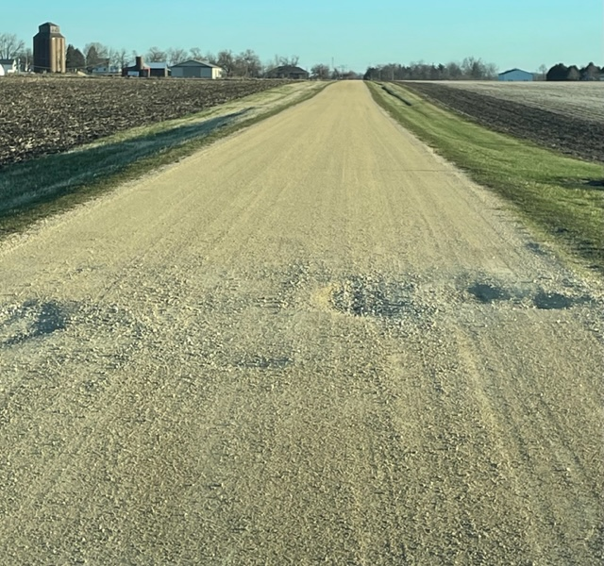
MAINTENANCE PROJECTS- ROAD DISTRICT
Road Stripping Maintenance
Gravel Road Repair

Slide 38
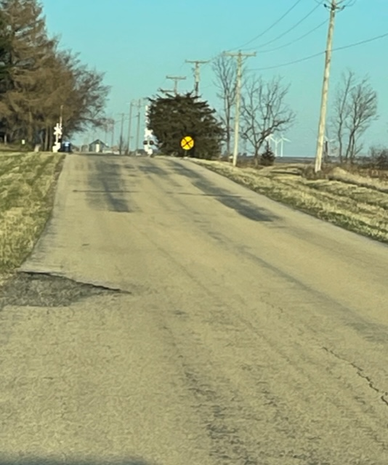
MAINTENANCE PROJECTS- ROAD DISTRICT
Minnigan Road Repairs
East of Crossing

Slide 39
AFTON TOWNSHIP
CAPITAL PROJECTS

Slide 40
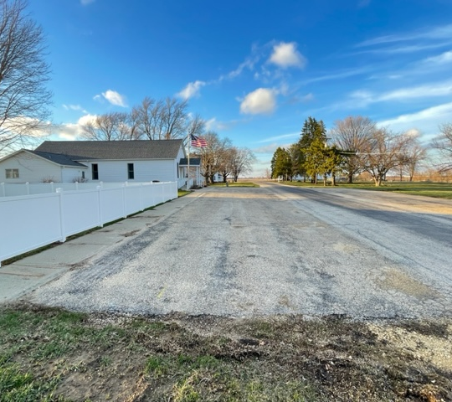
TOWNSHIP CAPITAL FUND PROJECT
Town Hall Parking Lot Improvements

Slide 41
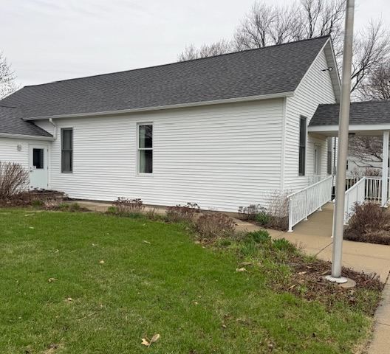
TOWNSHIP CAPITAL FUND PROJECT
Windows Replacement

Slide 42
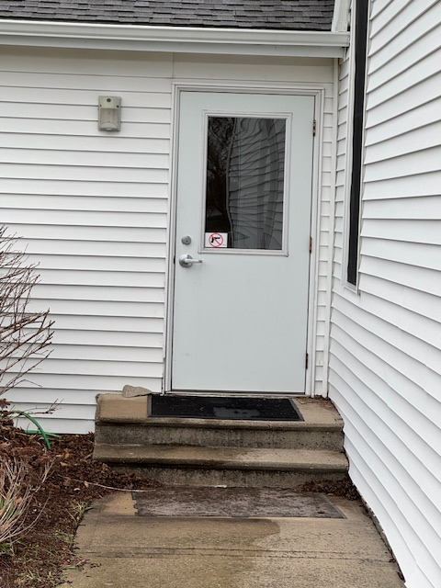
TOWNSHIP
CAPITAL FUND PROJECT
Exterior Door Replacement

Slide 43
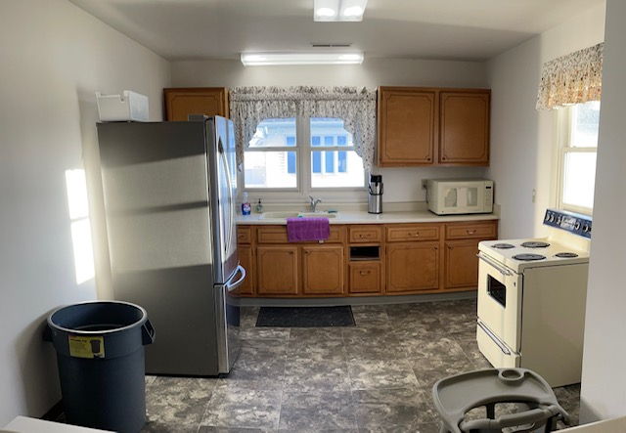
TOWNSHIP
CAPITAL FUND PROJECT
Town Hall Kitchen Modernization

Slide 44
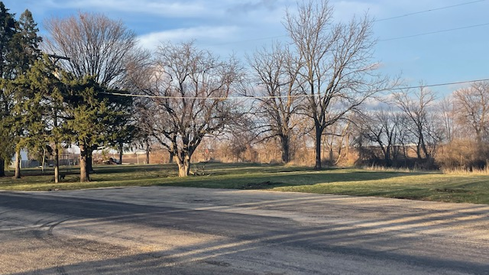
TOWNSHIP CAPITAL FUND PROJECT
New Well Location

Slide 45
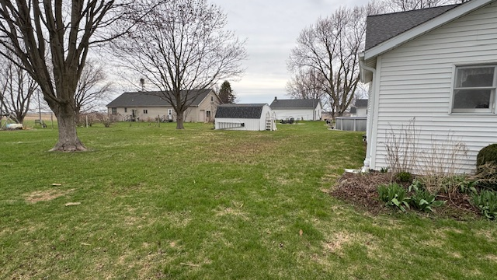
CAPITAL FUND PROJECTS- TOWNSHIP
New Septic Holding Tank Location

Slide 46
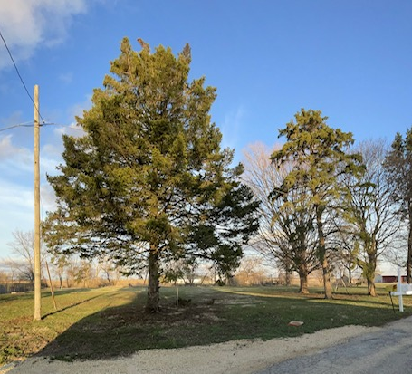
TOWNSHIP CAPITAL FUND PROJECT
Land Purchase

Slide 47
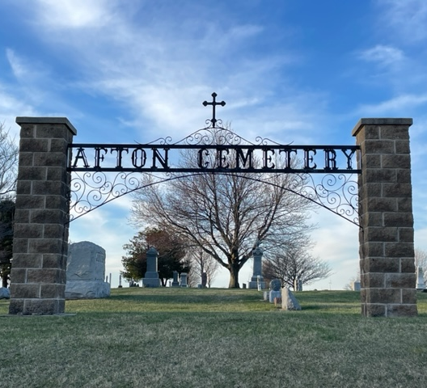
TOWNSHIP CAPITAL FUND PROJECT
Cemetery Headstone Repairs

Slide 48

PUBLIC PARTICIPATION

Slide 49
RULES
In order to secure the rights of the residents of Afton Township to a fair and just representation before their elected officials, and in order to guarantee to those duly elected officials an orderly and dignified forum in which to represent the rights of said residents, no person shall be allowed to engage in any activity that will disturb or disrupt the orderly proceedings of any public Township meeting. In order to attain this objective, the following Rules of conduct are established:

Slide 50
RULES
Any person who desires to address the Township Board, or any other subsidiary board or committee of the Township, at the time allotted by the said board for public comment, shall be permitted to speak only upon recognition of the presiding officer and, in so speaking, such person shall adhere to the following rules and provisions:
Please complete a form if you are wanting to speak and turn into the township clerk.

Slide 51
RULES
Each person addressing the board shall state his/her name for the record.
Each person shall be granted the opportunity to address the boar only once and no more than three (3) minutes, unless such time is extended by presiding officer.
Commentary shall be limited to township business
Commentary shall be directed to the presiding officer unless that officer permits commentary to be directed to board members or other officers present
Profanity shall not be used in any form or manner.
  Each person addressing the board shall state his/her name for the record.
Each person shall be granted the opportunity to address the board only once and no more than three (3) minutes per meeting, unless such time is extended by the presiding officer.
  Commentary shall be limited to township business.
  Commentary shall be directed to the presiding officer unless that officer permits the commentary to be directed to board members or other officers present.
  Profanity shall not be used in any form or manner.
  Questions regarding specific elected officials, officers or employees of the Township will not be entertained. Questions of this type may be addressed, in writing, to the presiding officer, who shall determine the appropriate method of response.
  Commentary shall take place in a professional manner which displays mutual respect for all persons involved.

Slide 52
RULES
Questions regarding specific elected officials, officers or employees of the Township will not be entertained. Questions of this type may be addressed, in writing, to the president officer, who shall determine the appropriate method of response.
Commentary shall take place in a professional manner which displays mutual respect for all person involved.
Members of the audience will not engage in conversation while the meeting is in session.
Members of the audience will not be permitted free movement about the meeting room while meeting is in scission.

Slide 53
RULES
Members of the audience may enter or leave the meeting room at any time provided such entrance or exit is made quietly and in an orderly fashion.
Cameras, including still cameras, movies cameras, and television cameras, using flashlights or lighting equipment other than the normal light furnished in the meeting room, will not be permitted while the meeting is in session, unless otherwise permitted by the presiding officer.

Slide 54
RULES
Battery operated recording equipment will be permitted, provided the operation of said equipment is silent. The microphone or sound recording device shall not be placed in the section of the meeting room designated for the use of the public officials, unless otherwise permitted by the presiding officer.
No audio or visual recording equipment may be set or
used in any manner so as to obstruct the view of any
person in the audience.
Individuals who appear to be visibly intoxicated or under the influence of any drugs shall not be allowed to address the
board.

Slide 55
RULES
Members of the audience may enter or leave the meeting

Slide 56

RESOLUTION NO. 2025-2026 A001 OPPOSING LEGISLATION TO ABOLISH TOWNSHIPS

Slide 57
SB 2217
TOWNSHIP CODE-
LOW POPULAITON DISSOLUTION
Provides that all townships with a population less than 5000 are dissolved and must either consolidate with an adjacent township or the county containing the geographic boundaries of the dissolving township.

Slide 58
SB 2504
TOWNSHIP CODE-
CONSOLIDATION AND MERGER
Amends the Property Tax Code. Provides that, in counties with a population of less than 50,000, the offices of township assessor and multi-township assessor are abolished upon the expiration of the term of a township assessor or multi-township assessor. Provides that the county assessor in a county of a population of less that 50,000 shall assume all the rights, powers, duties, assets property, liabilities, obligations, and responsibilities of township assessors or multi-township assessors with the county.

Slide 59
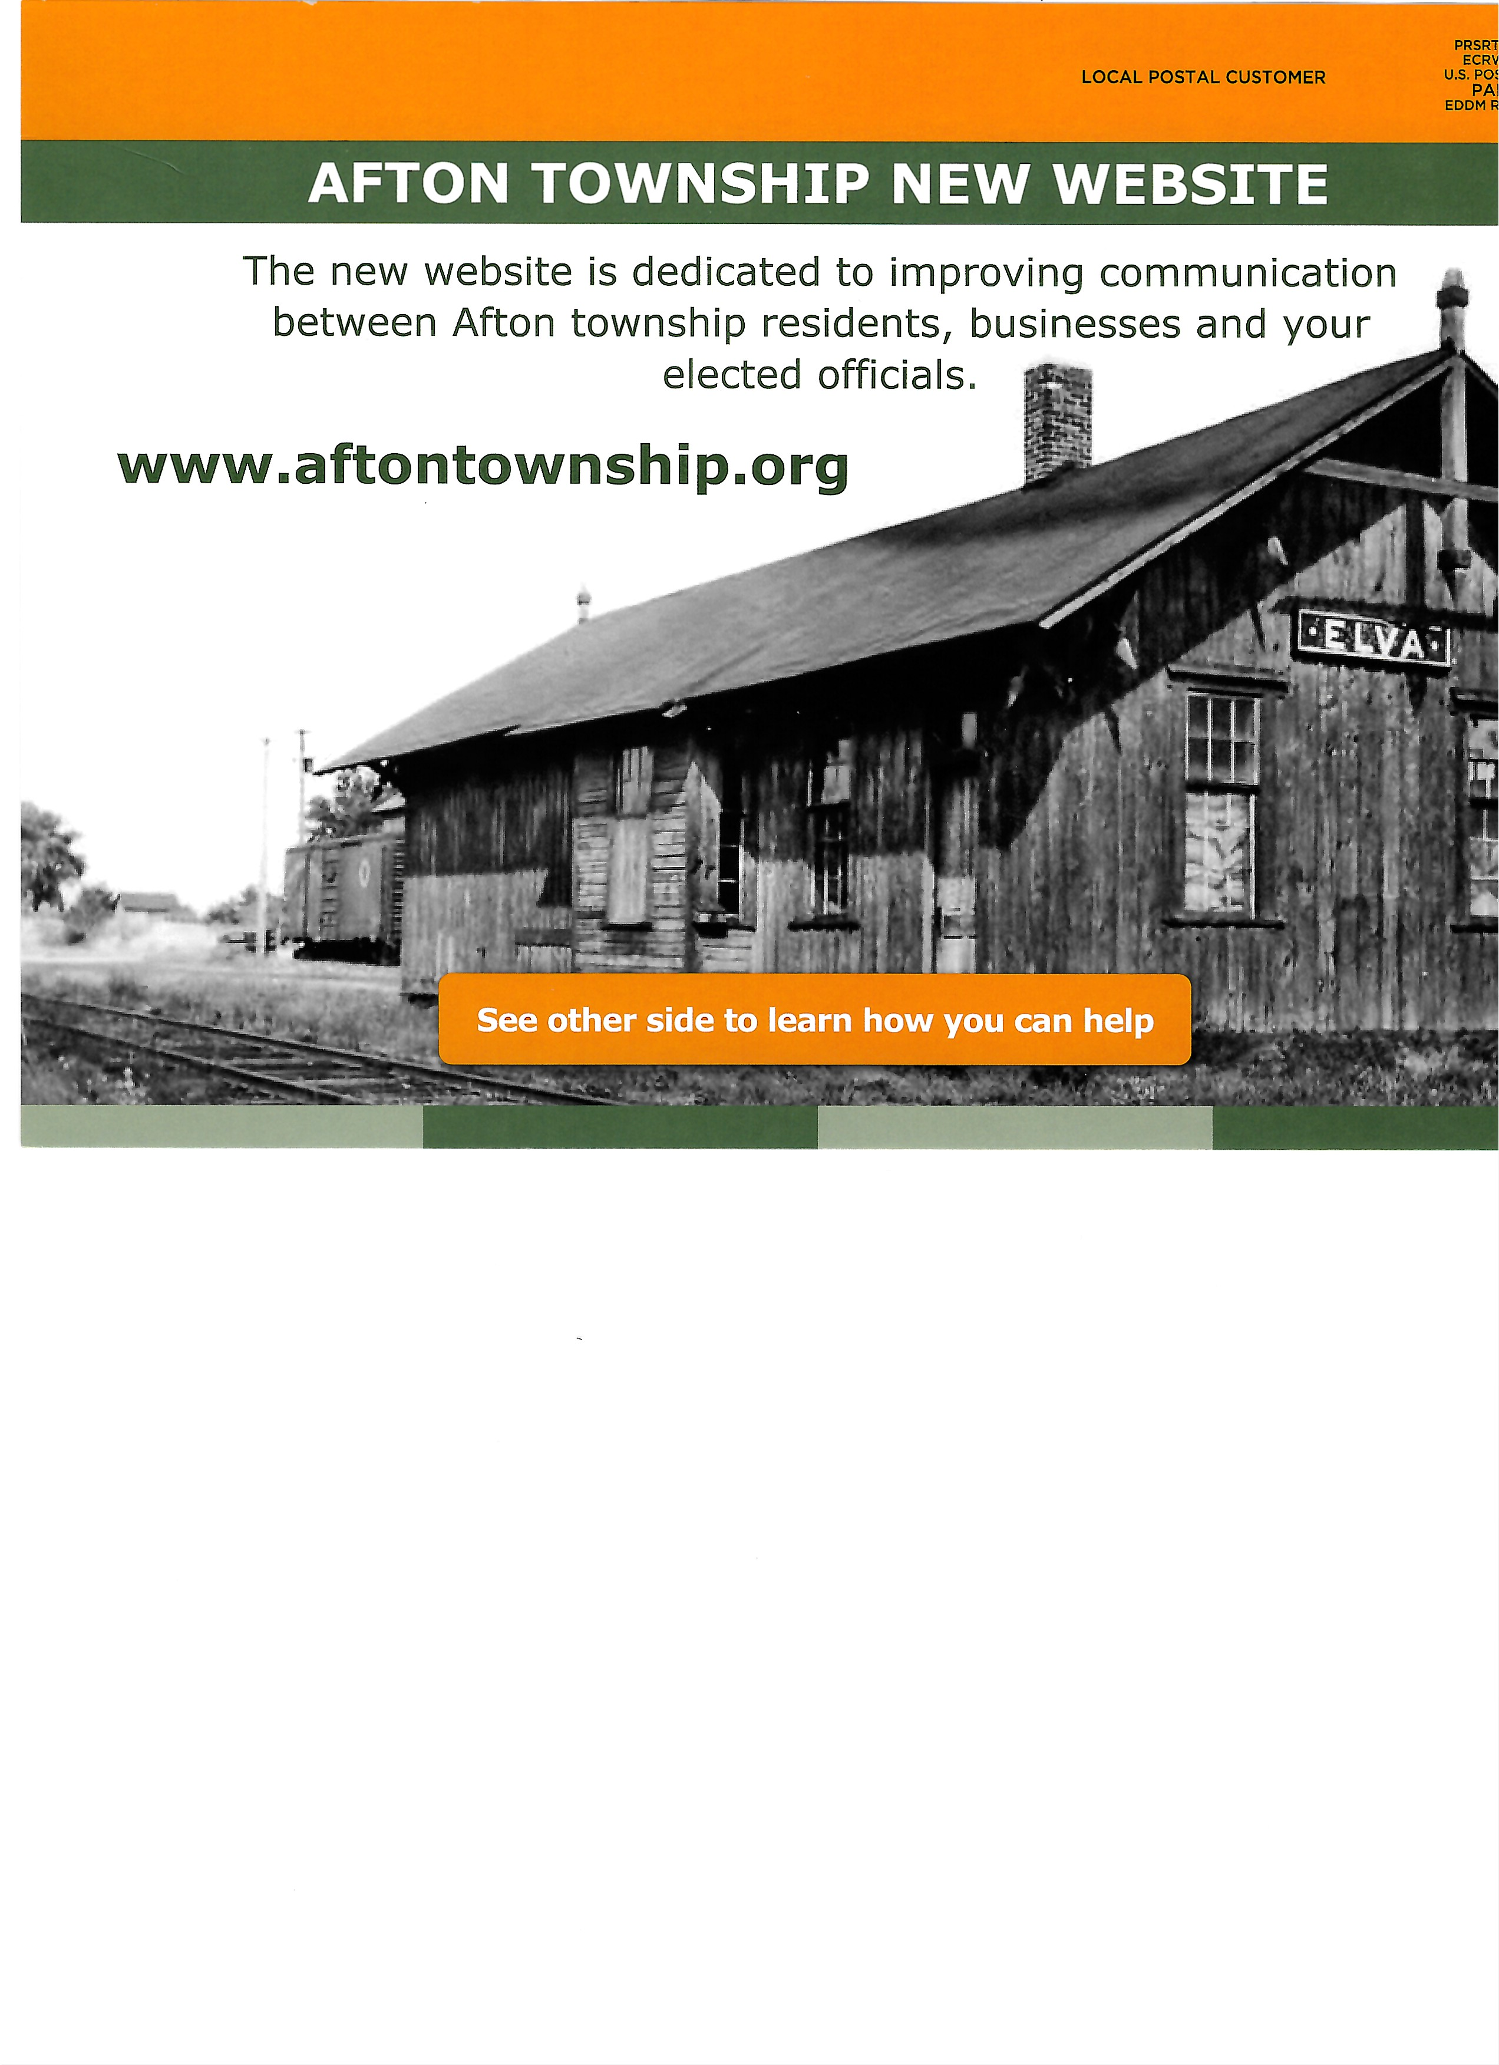
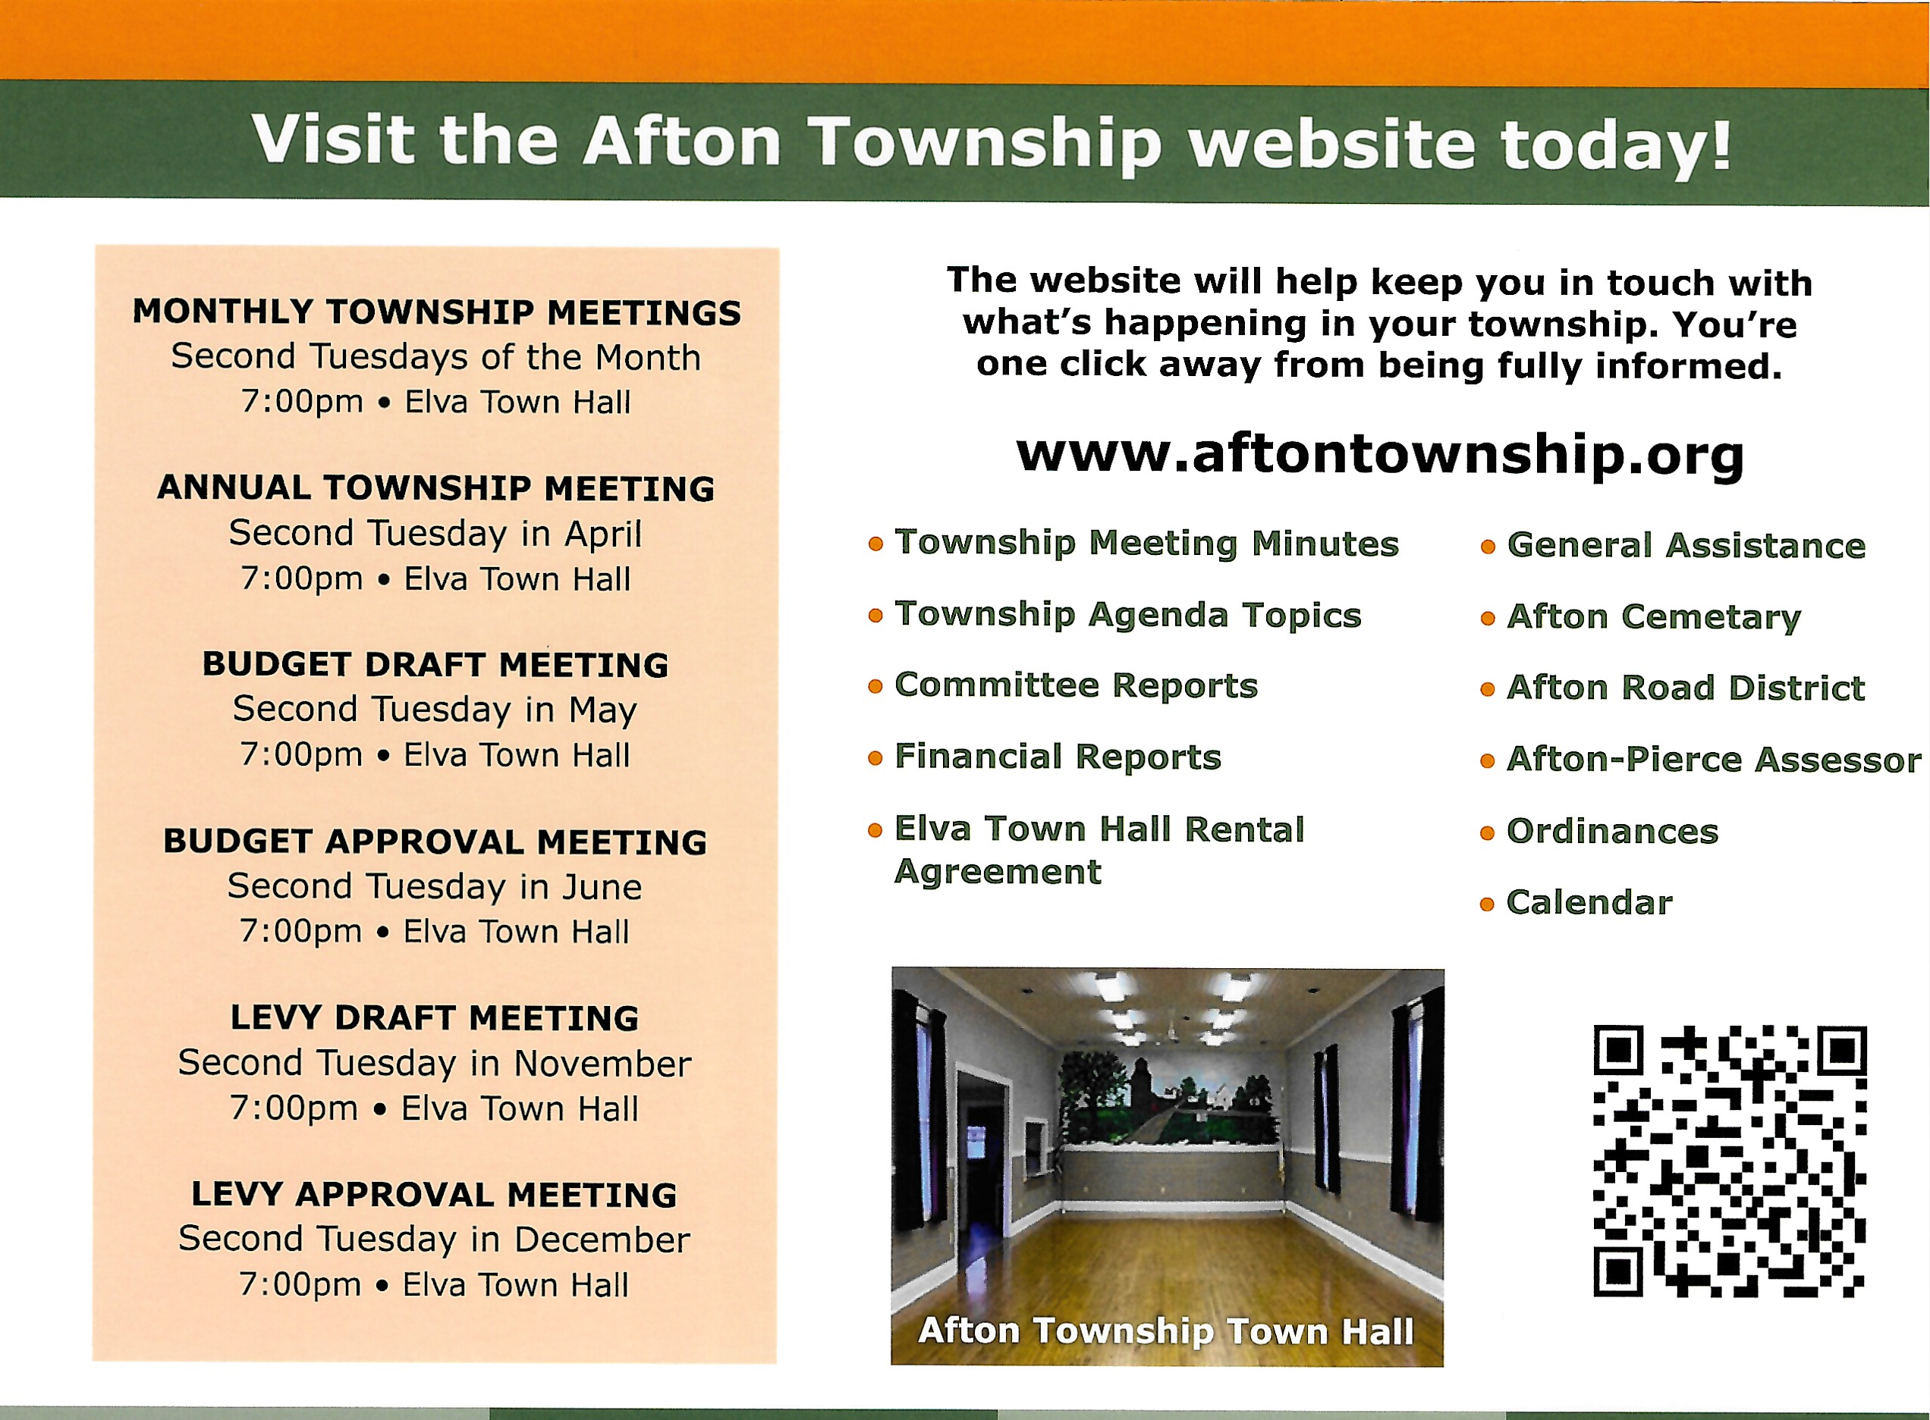
STAY CONNECTED
www.aftontownship.org

